Slide 1

IILM UNIVERSITY
Greater Noida
INTERNSHIP PRESENTATION
Full-Stack RAG Application
Deployment & AI Agent Automation
AI Deployment & Automation — 8-Week AICTE-EduSkills Virtual Internship
STUDENT NAME
Swati
ENROLLMENT NUMBER
2410031195
PROGRAM & SEMESTER
B.Tech CSE, Semester V
ORGANIZATION
EduSkills Academy (AICTE)

Slide 2
ABOUT THE ORGANIZATION
EduSkills Academy
CERTIFICATIONS & TRUST MARKS
EduSkills Academy is an ISO 9001:2015 & ISO 20000-1:2018 certified, ‘Great Place to Work’ certified skilling organization that partners with the All India Council for Technical Education (AICTE) to deliver industry-aligned virtual internships to engineering students nationwide through the National Internship Portal, under the mission “Nation Building Through Skills.”
ISO 9001:2015
ISO 20000-1:2018
Great Place to Work Certified
Director
IAO Certified
Bibek Ranjan
GM, Learning & Development
Govt. of India Recognized Skilling Partner
Mitu Swain
Patronage
AICTE Supported
AICTE – National Internship Portal
2

Slide 3
INTERNSHIP OVERVIEW
Program Snapshot
1
2
3
DOMAIN
DURATION
MODE
AI Deployment & Automation
8 Weeks (June – August 2026)
AICTE – EduSkills Virtual Internship
4
5
6
INSTITUTE
BRANCH
CREDENTIAL
IILM University, Greater Noida
B.Tech, Computer Science & Engineering
Internship Completion Certificate
3

Slide 4
OBJECTIVES
Internship Objectives
1
Understand the complete AI deployment lifecycle — from model integration to production monitoring
2
Build & serve models through high-performance, asynchronous FastAPI services
3
Containerize AI applications with Docker and manage multi-service environments
4
Deploy generative AI / RAG applications on AWS SageMaker, Google Vertex AI & Azure ML
5
Design AI agents with LangChain, LlamaIndex & LangGraph for business automation
6
Orchestrate services with Kubernetes and implement monitoring with Prometheus & Grafana
7
Detect model drift, retrain, and optimize performance & cloud cost
8
Deliver a capstone full-stack RAG application integrated with a business-automation agent
4

Slide 5
PROGRAMME STRUCTURE
8-Week Curriculum — Weeks 1–4
W1
W2
W3
W4
AI Deployment Foundations & FastAPI
Containerization & CI/CD
Cloud AI & Generative AI Serving
AI Agents & Automation Workflows
AI lifecycle, production readiness, MLOps terminology, environment setup, async API deployment with FastAPI.
Docker architecture, Dockerfiles, networking, volumes, MLOps principles, CI/CD pipelines for ML workflows.
Deployment on AWS SageMaker, Vertex AI, Azure ML; generative AI apps, LLM challenges, vLLM, quantization.
Advanced agents with LangChain & LlamaIndex, orchestration with LangGraph, hyper-automation workflows.
5

Slide 6
PROGRAMME STRUCTURE
8-Week Curriculum — Weeks 5–8
W5
W6
W7
W8
AI Integration, Security & Compliance
Kubernetes & Observability
Performance, Drift & Advanced RAG
Applied & Capstone Projects
Integrating AI into web/mobile apps with Streamlit & Gradio; securing systems; privacy & bias mitigation.
Container orchestration — Pods, Deployments, Services; monitoring & logging with Prometheus and Grafana.
Performance tuning, cost optimization, drift detection (Evidently AI), retraining, advanced RAG, vector DBs.
E-commerce & healthcare case studies; full-stack RAG app; AI agent for automation; end-to-end AI solution.
6

Slide 7
TECH STACK
Technologies & Tools Used
Programming & APIs
Containers & Orchestration
1
2
Python · FastAPI · Async/Await
Docker · Docker Compose · Kubernetes
CI/CD & MLOps
Cloud Platforms
3
4
CI/CD Pipelines · MLOps Practices
AWS SageMaker · Google Vertex AI · Azure ML
Generative AI & Agents
Front-End Integration
5
6
vLLM · Quantization · LangChain · LlamaIndex · LangGraph
Streamlit · Gradio
Monitoring & Observability
Drift & Retraining
7
8
Prometheus · Grafana
Evidently AI · Vector Databases
7

Slide 8
CAPSTONE PROJECT
End-to-End System Architecture
Knowledge Layer — Vector Database (Embeddings)
Model-Serving Layer — FastAPI (REST Endpoints)
Containerization Layer — Docker Images
Orchestration Layer — Kubernetes (Pods / Deployments / Services)
Cloud Layer — AWS SageMaker / Vertex AI / Azure ML
Agent Layer — LangChain / LlamaIndex / LangGraph
Interface Layer — Streamlit / Gradio Front-End
Observability Layer — Prometheus, Grafana & Evidently AI
8

Slide 9
CAPSTONE PROJECT
Applied Case Studies & Deliverables
1
2
3
Full-Stack RAG Application
AI Agent for Business Automation
E-commerce & Healthcare Case Studies
Designed and deployed a Retrieval-Augmented Generation application with a FastAPI backend, vector-database retrieval and a lightweight web front-end, containerized with Docker and served via Kubernetes.
Built a LangChain / LlamaIndex / LangGraph-based agent that automates a representative business workflow, integrated with the RAG service for context-aware decisions.
Analyzed real-world case studies to apply production AI concepts — model serving, drift detection, and cost-optimized cloud deployment — to two industry contexts.
9

Slide 10
KEY LEARNINGS
Skills & Competencies Gained
✓
Production-grade API design and asynchronous model serving
✓
Containerization and CI/CD for reliable, repeatable ML deployments
✓
Multi-cloud AI deployment across AWS, Google Cloud and Azure
✓
Building and orchestrating autonomous AI agents for automation
✓
Kubernetes-based scaling and observability (Prometheus/Grafana)
✓
Responsible AI practices: security, privacy and bias mitigation
✓
Model drift detection, retraining and cost-optimized operations
✓
End-to-end delivery of a production-style RAG solution
10

Slide 11
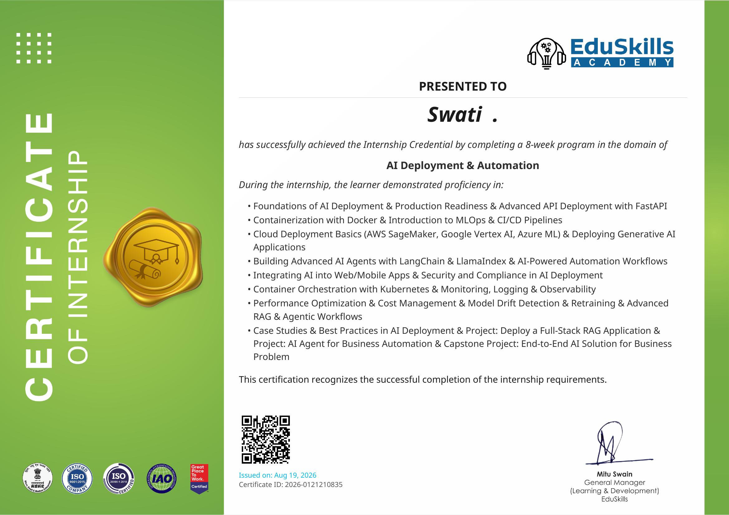
RECOGNITION
Internship Completion Certificate
Certificate ID: 2026-0121210835 · Issued: 19 Aug 2026 · Domain: AI Deployment & Automation
11

Slide 12
Conclusion
This internship provided hands-on, production-oriented experience across the full AI deployment lifecycle — from API design to cloud-scale orchestration and agentic automation. The capstone RAG application and business-automation agent demonstrate the ability to take an AI solution from concept to a secure, monitored, end-to-end deployment, strengthening readiness for real-world AI engineering roles.
Thank You
Swati · 2410031195 · B.Tech CSE, Semester V · IILM University, Greater Noida
12

